Slide 1
Executive Sponsors Meeting
March 22, 2018

Slide 2
Agenda
Status Dashboard
Support Approach (Draft)
Project Schedule
Testing Entry / Exit Criteria
Revised Information Flow
Special Requests
Customization / Interface Update
Risks and Mitigation
Action Items – Previous Meeting

Slide 3
Status Dashboard
OwlConnect Project Overall Status
Y
Topic | Milestone | Status Towards Milestone | Comments
Design / Test | Scripting ready 3/12 |  | Testing and UAT preparations continue, with support from consultants
Conversion | All tickets resolved by 4/13 for next conversion cycle |  | Managing scope for a targeted 85% accurate conversion run in April / May 2018 Continue to focus on working issues / closing tickets
Interfaces | Interfaces tested by Rice and ready for UAT by 3/12 |  | Blackbaud resource onsite 3/5 for testing support Interfaces being tested and prioritized for go-live
Reporting | Reporting design complete 3/9 |  | After Blackbaud onsite, revised functional design delivered (under review)
Scope | N/A |  | Additional change orders continue to be identified Changes are being prioritized for go-live criticality
Budget | N/A |  | Expenditures appear to be in line with approved funding
Technical | 2/23 |  | Load balancer upgrade completed on time
Deployment Readiness | UAT 1 checkpoint by 4/13 |  | Precision Partners survey – responses being compiled Checkpoint after first round of testing
Y
Y
Y
R
Y
Y
C
G

Slide 4
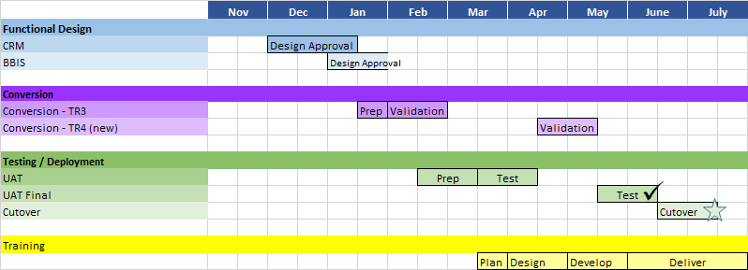
Project Schedule
Go-live is scheduled for July 2018, following fiscal year-end close.
The project has entered the testing phase.
Go / No-Go: week of June 11

Slide 5
Test Entry / Exit Criteria
ENTRANCE CRITERIA | Status
Configuration/setups completed | Y
Test instance created | G
Interfaces ready for testing | Y
Test condition Scripting >90% complete | Y
Functional and technical teams on standby for break-fix work | Y
Required test data documented and set up for testing | G
EXIT CRITERIA | Target | Actual | OK?
Successful execution of ‘required’ test conditions | >90%
Test results documented for executed scripts | 100%
Overall script execution | >90%
Open ‘Critical’ issues/work requests | <10 / <10%
Testers participation according to schedule | >90%
Acceptance of risk associated with outstanding issues | Yes

Slide 6
Revised Information Flow: Design Status
Key
One way: to CRM
One way: from CRM
Two way
Gifts / Bio Updates
Campus Call
Sallyportal
Alumni, Faculty, Parents
Current SQL Database
BBIS
Bio Updates
Banner
Linked Documents
Funds
Financial
OnBase - AE
Gifts
BB CRM
Corporate Participation in Job Fairs, Events, and Recruiting
Sponsored Research
Sponsored Research
BB DW
Handshake
Scholarships
Financial Aid
Key:
Being Tested
Issues Found
Not yet designed
Payroll Deductions
Payroll
Students / Faculty, Staff
Master Data
Pres Partner Dashboard
Rice DW
Web Forms

Slide 7
Special Requests
Request | Cost | Status
Data Warehouse Extension | One time, $15k | Open request
Possible plug-in for 2 factor authentication | $20K | Open request
Reporting design onsite closeout (2 onsite) | 40 hours no cost to Rice | Approved
Bing maps | $ 120 / year for 3 years | Open request
Custom Name Formats | $ 5,000 one time + 30 hours | Approved
Data Loader (Precision Partners) | $ 15,000 / year for 3 years | Approved
Extra conversion support from PP | $ 21,000 | Approved
Engagement of Zuri Group consultants | $ 80,000 | Approved
Additional Blackbaud support for go-live (515 hrs), including: Secure access to alumni resources (50 hrs) Custom Name Formats modification (30 hrs) | $ 80,975 | Approved
Secure access to alumni resources | 50 hours (estimated 10,000) | Approved

Slide 8
Risks and Mitigation
# | Risk / Issue | Mitigation | Change
1 | Time required from DAR employees continues to escalate: UAT, preparations for next conversion cycle, planning for post go-live support model. | Support by Zuri (UAT) and Precision Partners (Conversion); requirements for support model under development with leads
2 | Data conversion: New scope adding risk to next conversion cycle | Blackbaud conversion analyst to estimate impact of new requirements; change requests will be evaluated for priority and timing
3 | Jones School resource availability limited to focus on OwlConnect | Resource availability to perform cleanup, project activities, and future support remains a risk. Karen has begun conversations with Jody Sommer and Katherine Schieffelin
4 | Readiness for UAT | Engaged Zuri group for scripting support; developed highest priority scripts for first week of UAT
5 | Budget risk - Additional functionality requested from Blackbaud to fit business requirements | Budget reviewed and so far within allocated funding
6 | June / July business processes may be impacted by Go Live and Stabilization requirements | Discussions upcoming: expectations and activities during / after go-live
7 | Reporting delayed | Reporting design delivered, under review
Y
Y
R
Y
Y
G
R
Notes:
Back pocket: Slippage and impact..

Slide 9
Action Items – Previous Meeting
Action | Responsible | Status
Executive Sponsor Review call with Blackbaud | Karen | Held on March 20
Follow up – future support plans for Jones and Baker Institute | Darrow / Karen | Jones support discussions taking place
Schedule OwlConnect presentation at Deans’ Council | Darrow / Klara | Schedule for February
Schedule Glasscock presentation / WIIFM | Kathy / Karen | For discussion with Dauwn
Implementation of 2-factor authentication | Kathy / Karen | Upcoming meeting on Thursday to review Blackbaud proposal for plug-in
Begin planning for support | Karen | Included for discussion / BAC topic

